Slide 1


Visualizing Data in R using ggplot2
Lauren Nichols
Lmn7@duke.edu
Data Visualization Specialist

Slide 2

Visualizing Data in R using ggplot2
Lauren Nichols
Lmn7@duke.edu

Slide 3
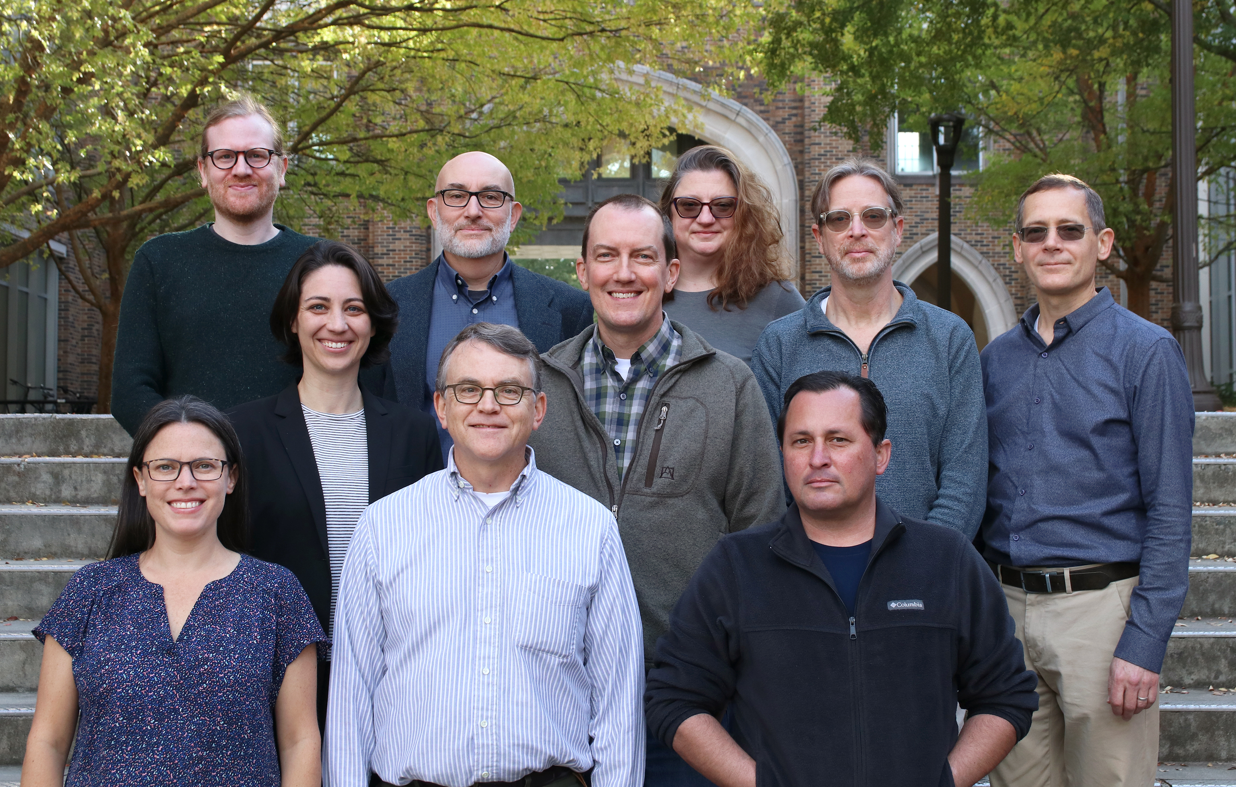
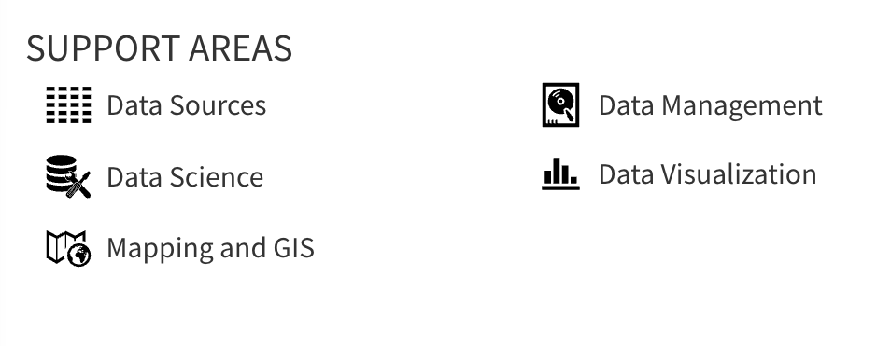
Center for Data & Visualization Sciences (CDVS)
AskData@duke.edu
Notes:
We offer workshops and individual consultation

Slide 4


VS

Slide 5
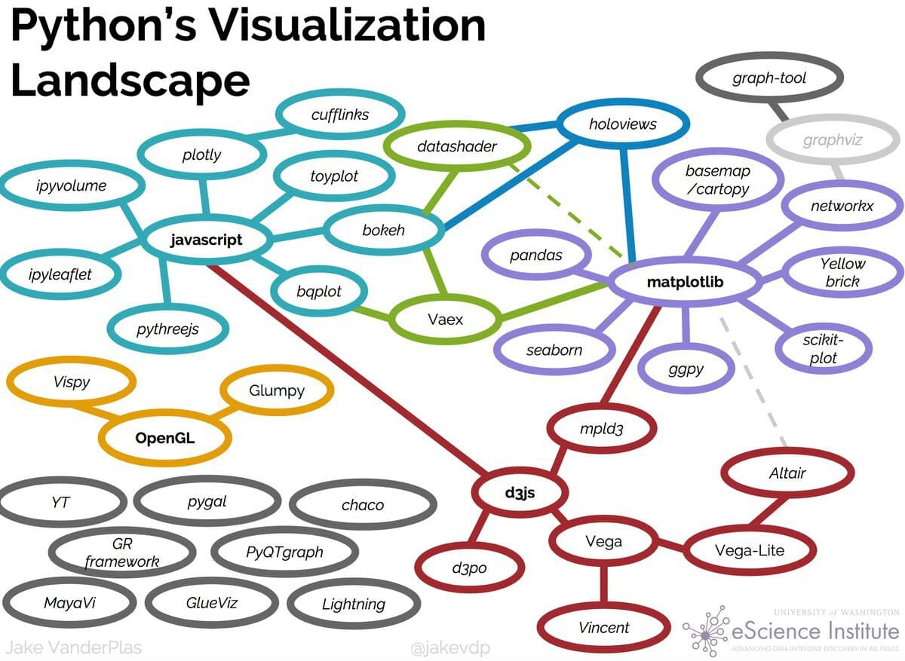

Slide 6
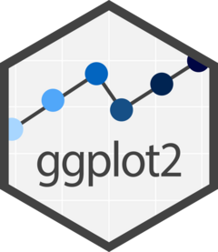
leaflet
r2d3

Slide 8
“gg” in ggplot2 stands for “Grammar of Graphics”
Notes:
(move it over)

Slide 9
Data
Aesthetics
Geometries
Statistics
“gg” in ggplot2 stands for “Grammar of Graphics”
Graphics are built by layering elements
Scales
Themes
Notes:
(move it over)

Slide 10
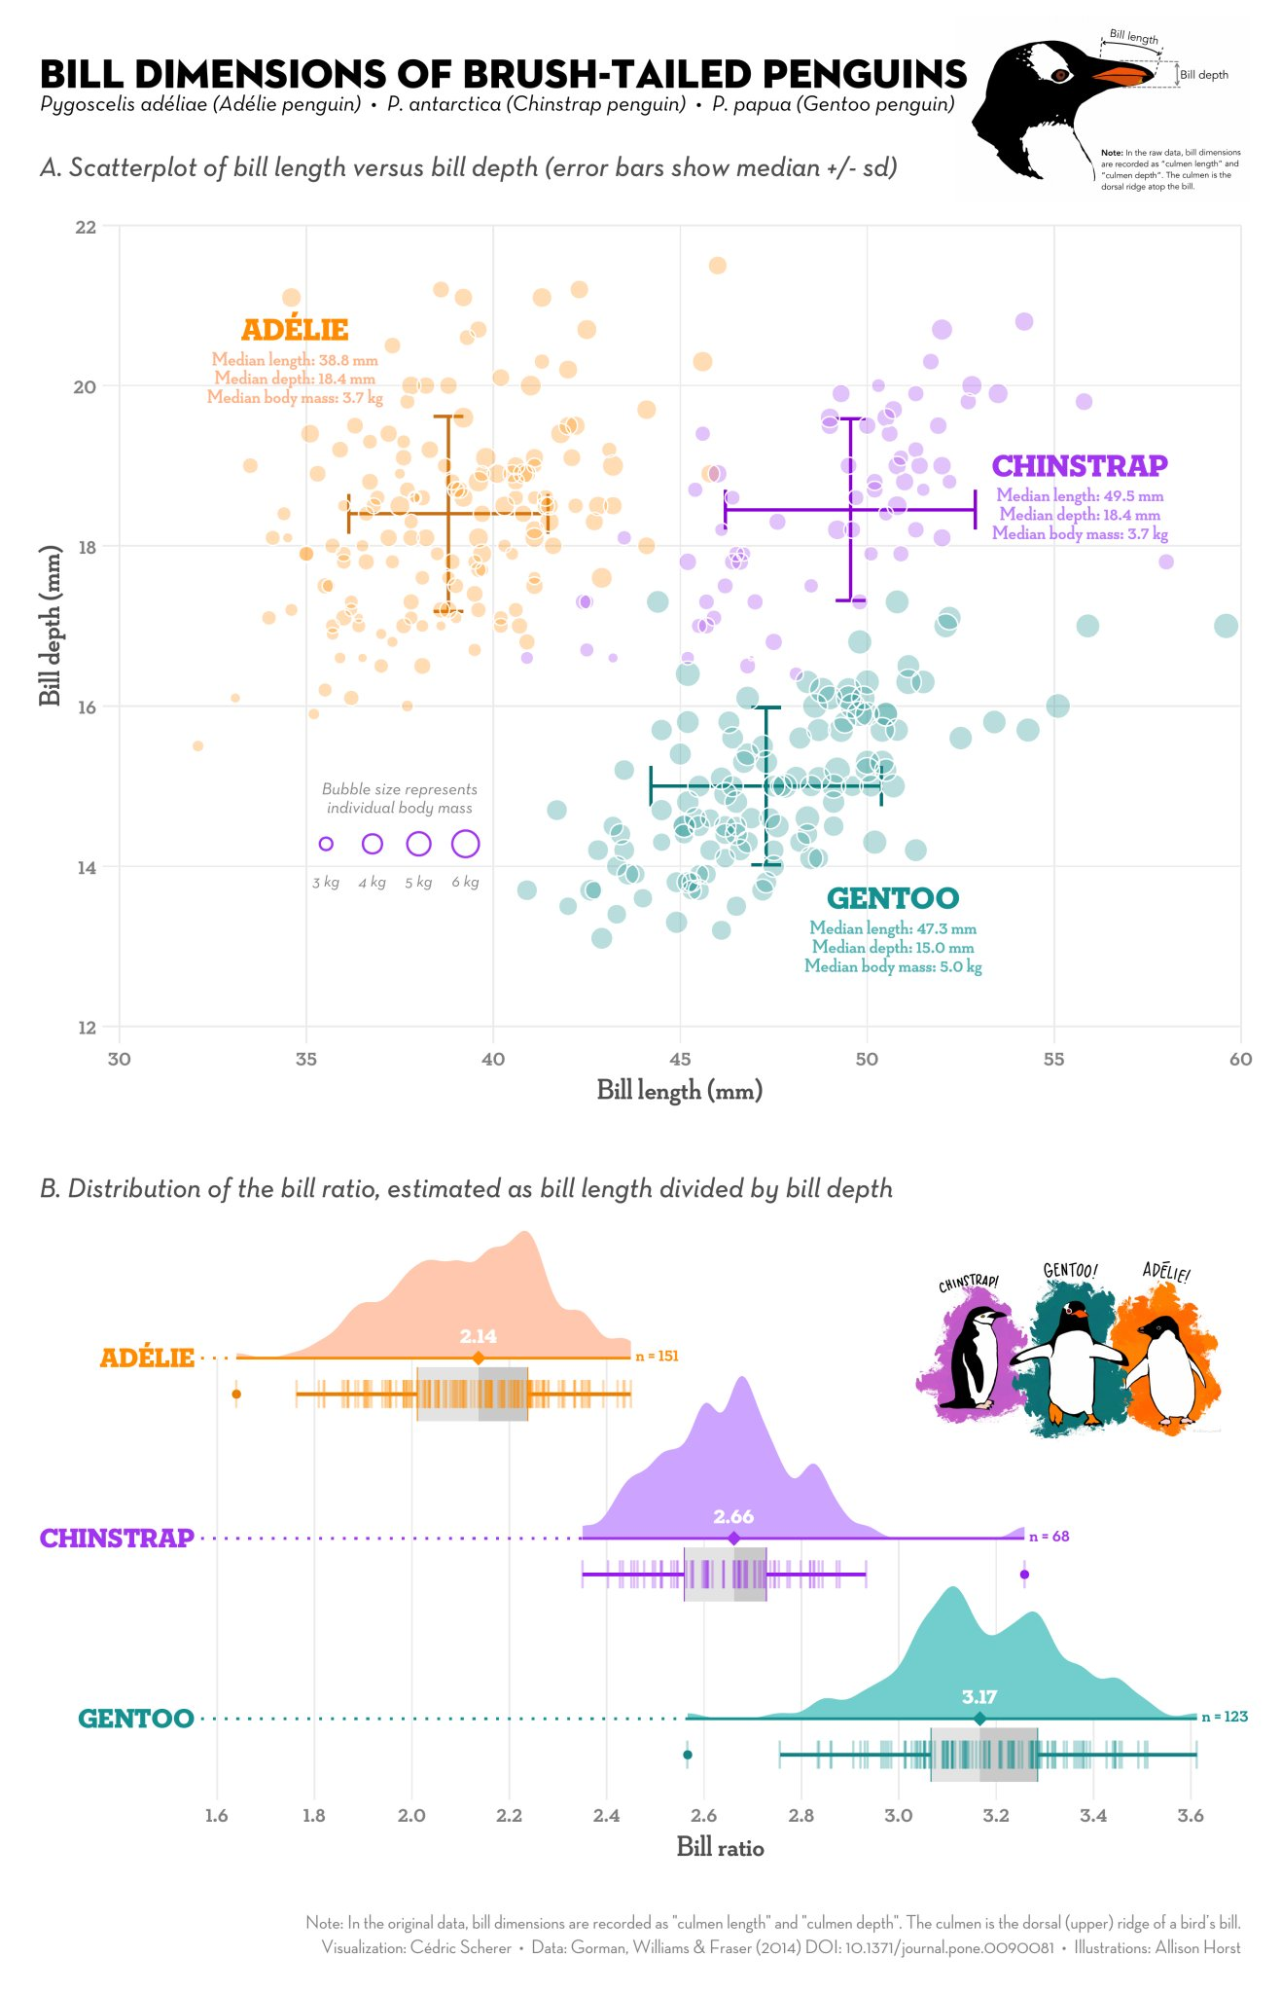
Notes:
Integration with analysis in R
Succinct
Versatile
Publication ready graphics
(or at least pretty close to it)

Slide 11
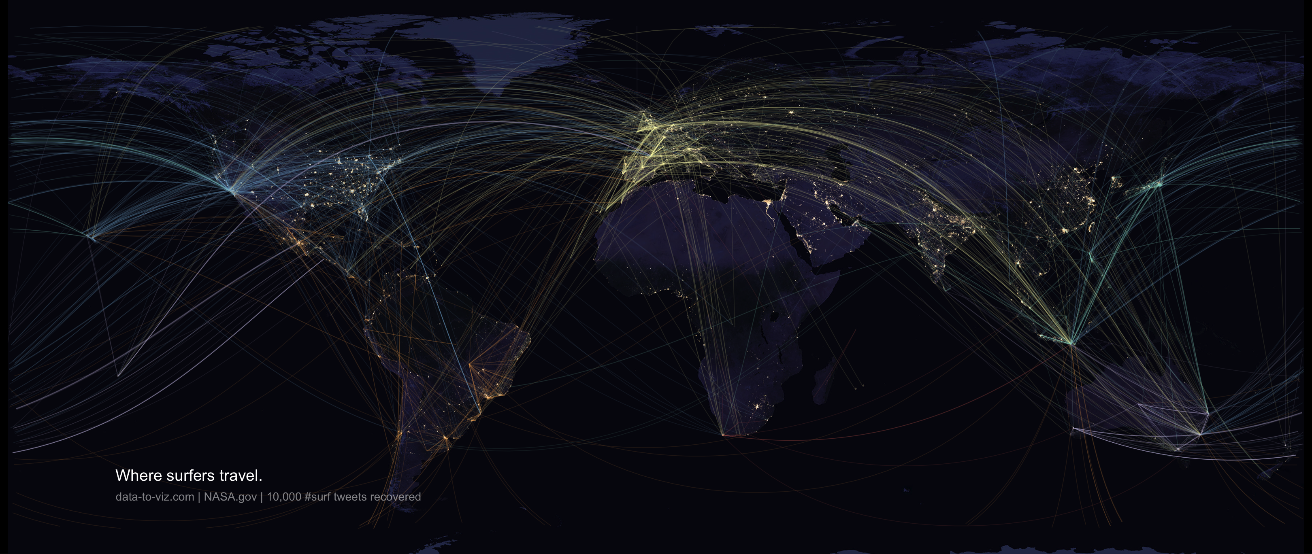
Notes:
Bespoke figures

Slide 12
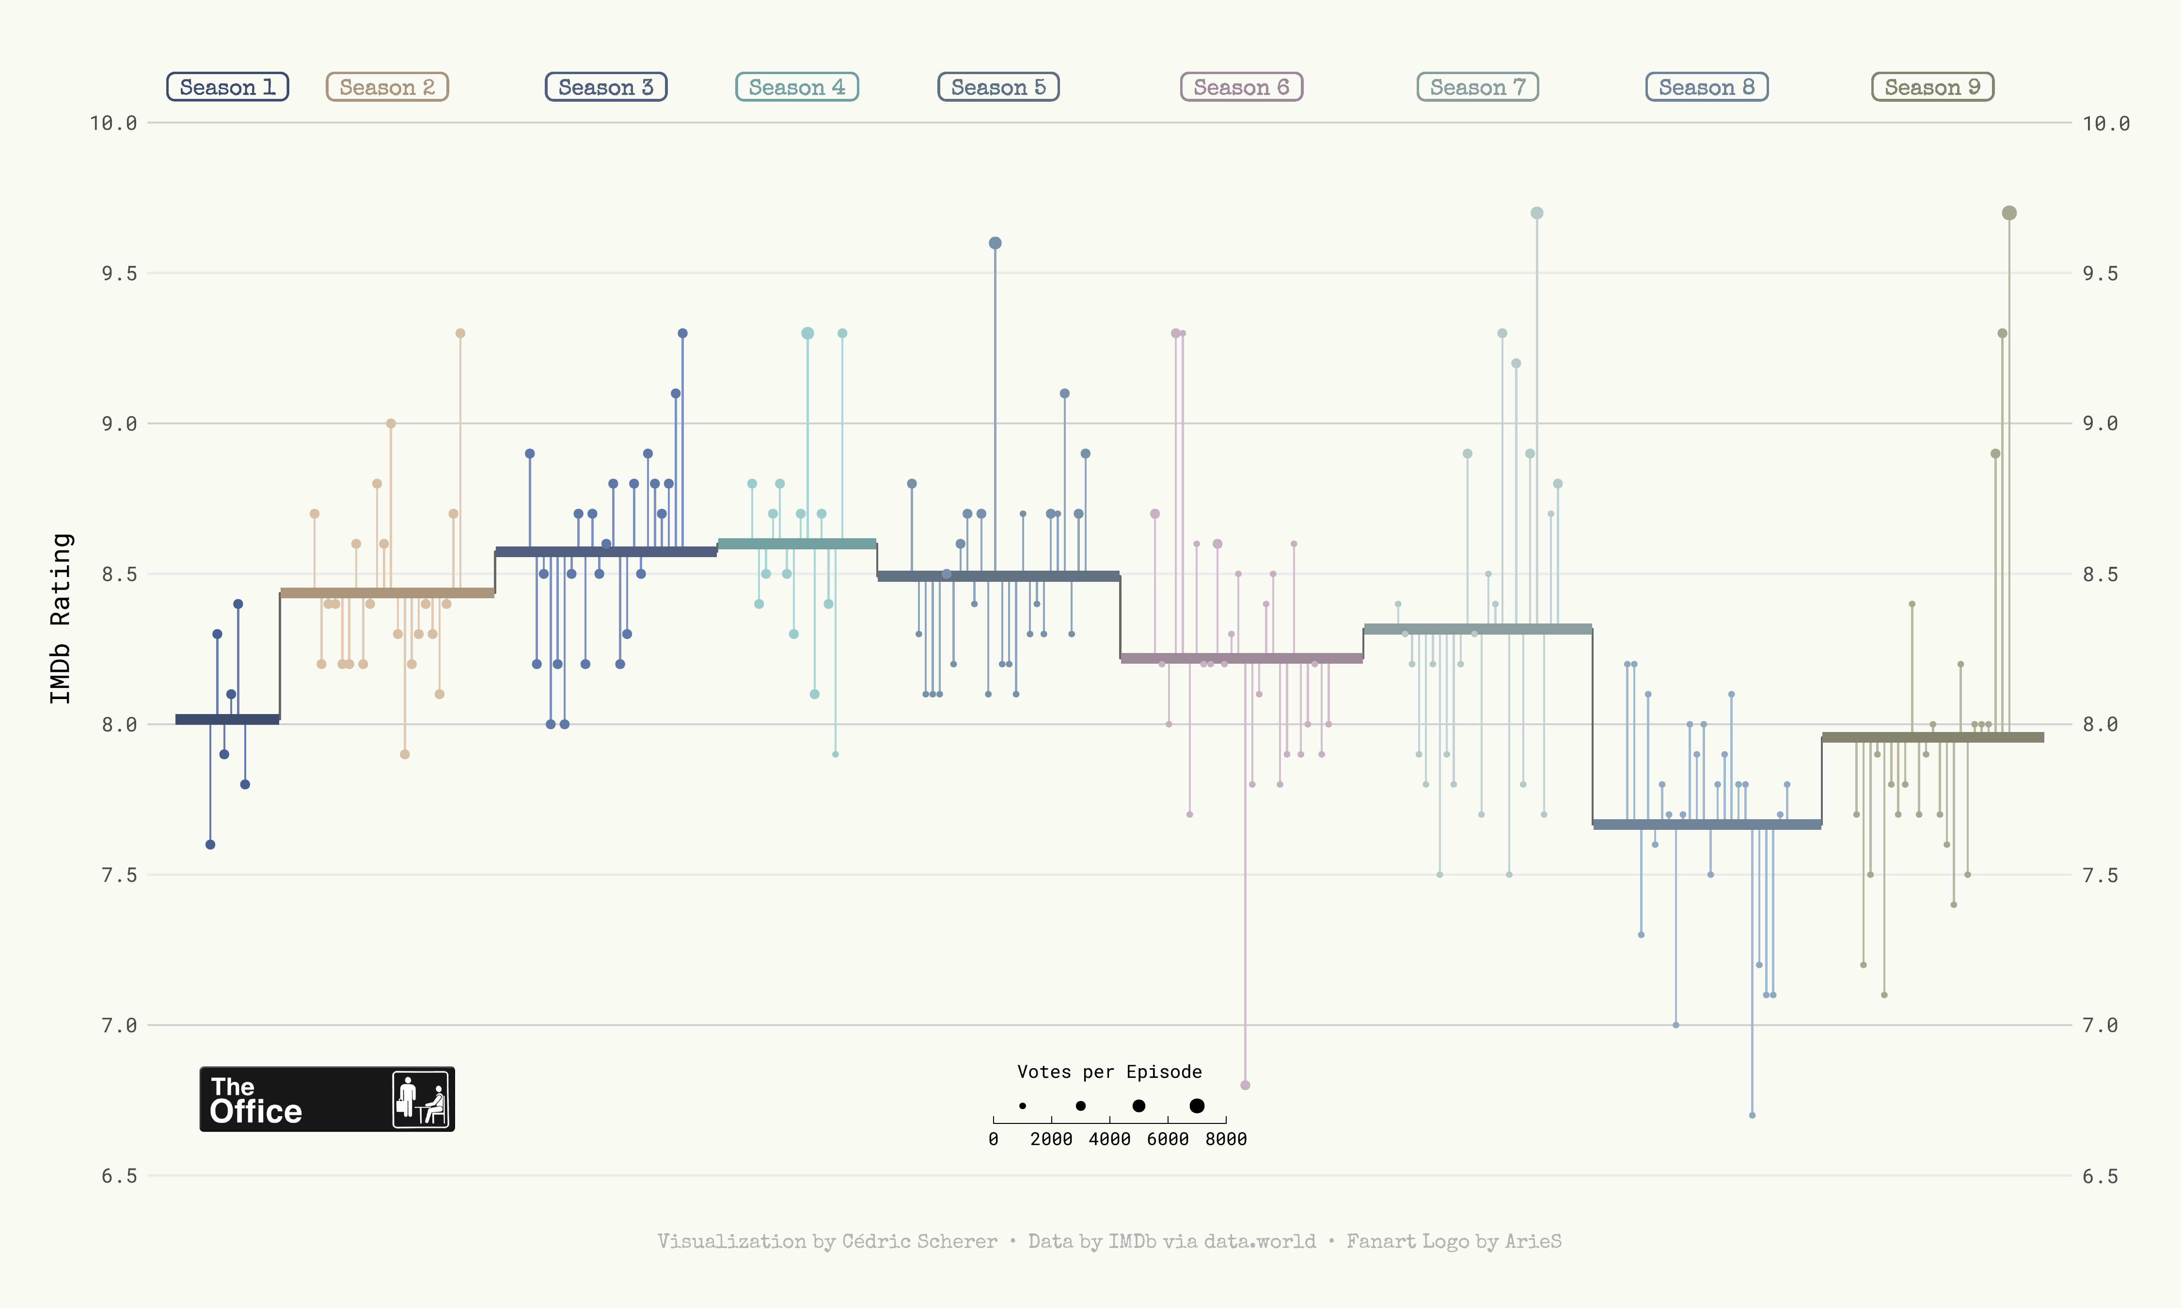

Slide 13
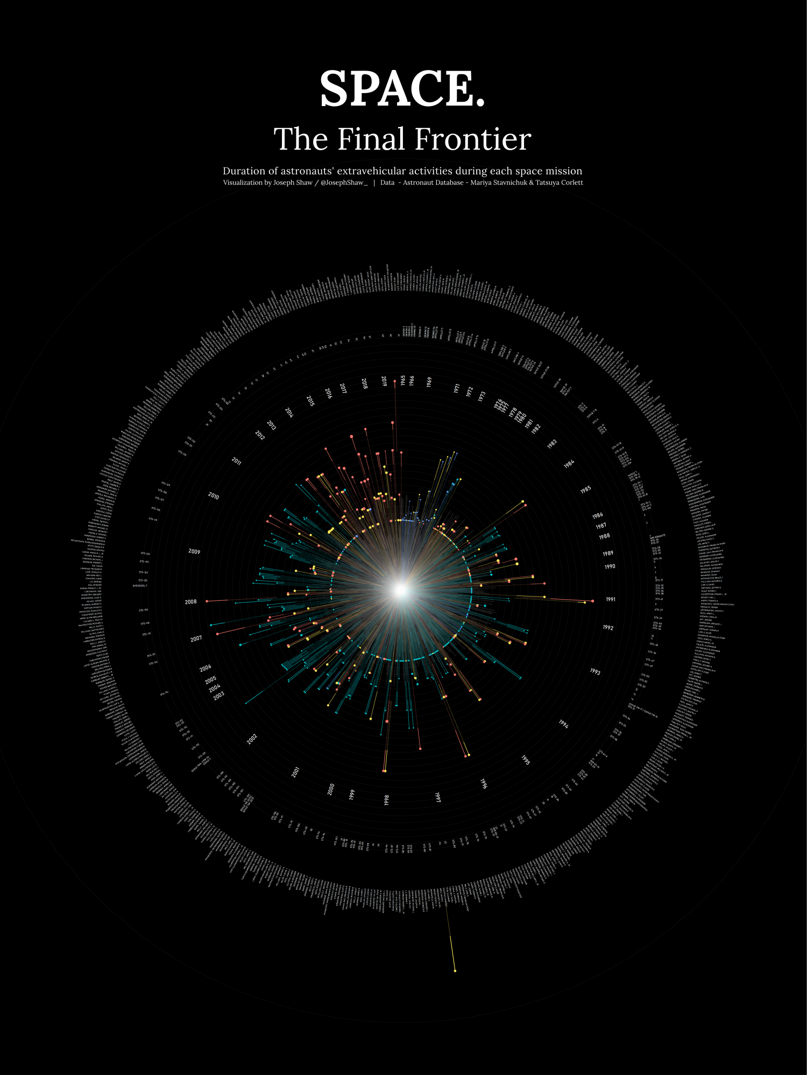
github.com/joseph-shaw/tidytuesday/

Slide 14
github.com/joseph-shaw/tidytuesday/

Slide 15
Data
ggplot(
data = yourdata
,
Mapping
mapping = aes(x axis, y axis)
) +
geometry function
+
Geometries
statistics function
+
Statistics
scales function
+
themes function
Scales
Themes
Notes:
method chaining with a +

Slide 16
Data
ggplot(
data = yourdata
,
Aesthetics
mapping = aes(x axis, y axis)
) +
geometry function
+
Geometries
statistics function
+
Statistics
scales function
+
themes function
Scales
Themes
Notes:
method chaining with a +

Slide 17
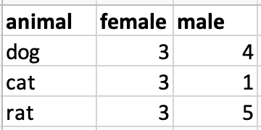
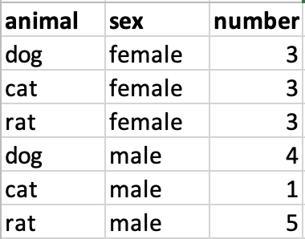
Data Format
Wide data
Long data

Slide 18
Data Format
Wide data
Long data
f

Slide 19
Data Format
Wide data
Long data
f
Wide_data = spread(Long_data, sex, number)

Slide 20
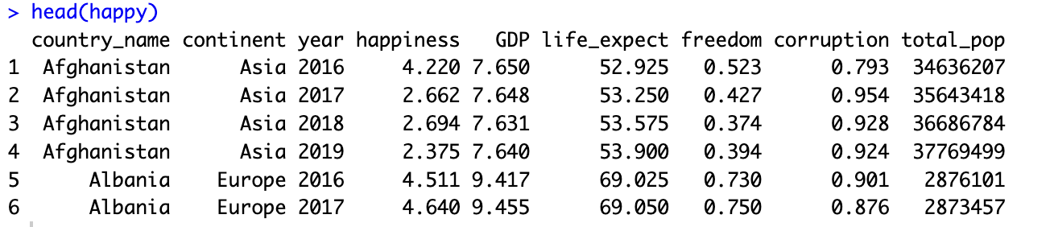

Slide 22
Data
ggplot(
data = yourdata
,
Notes:
method chaining with a +

Slide 23
Data
,
)
ggplot(
data = yourdata
,
aes(x axis, y axis)
Aesthetics
(variables)
Notes:
method chaining with a +

Slide 24
Data
,
) +
ggplot(
data = yourdata
,
aes(x axis, y axis)
Aesthetics
geometry function
Geometries
Notes:
method chaining with a +

Slide 25
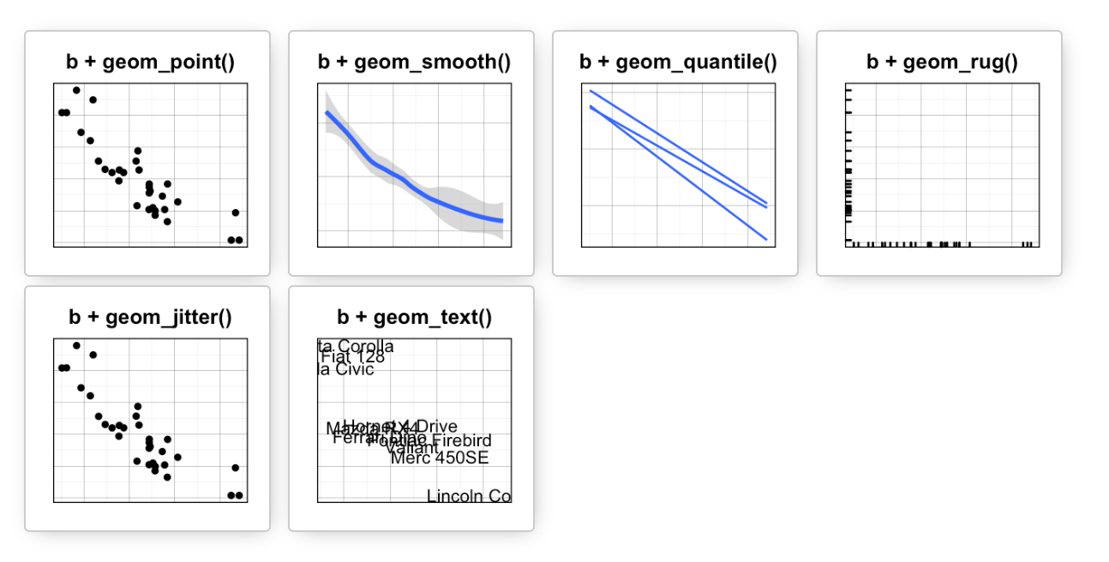
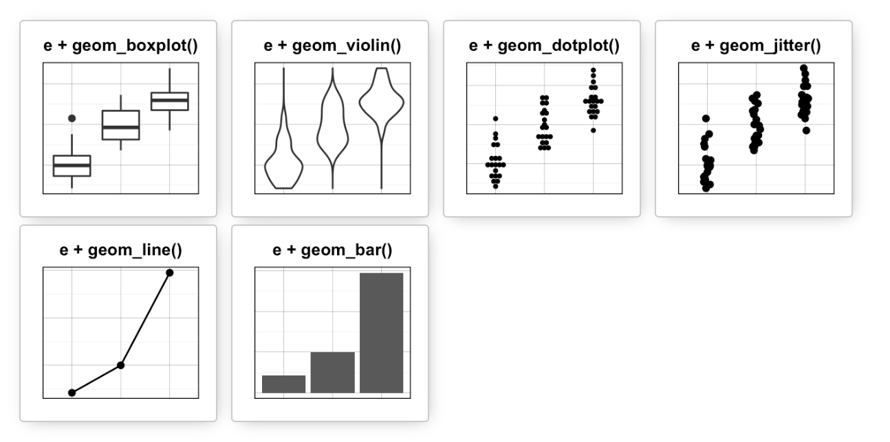
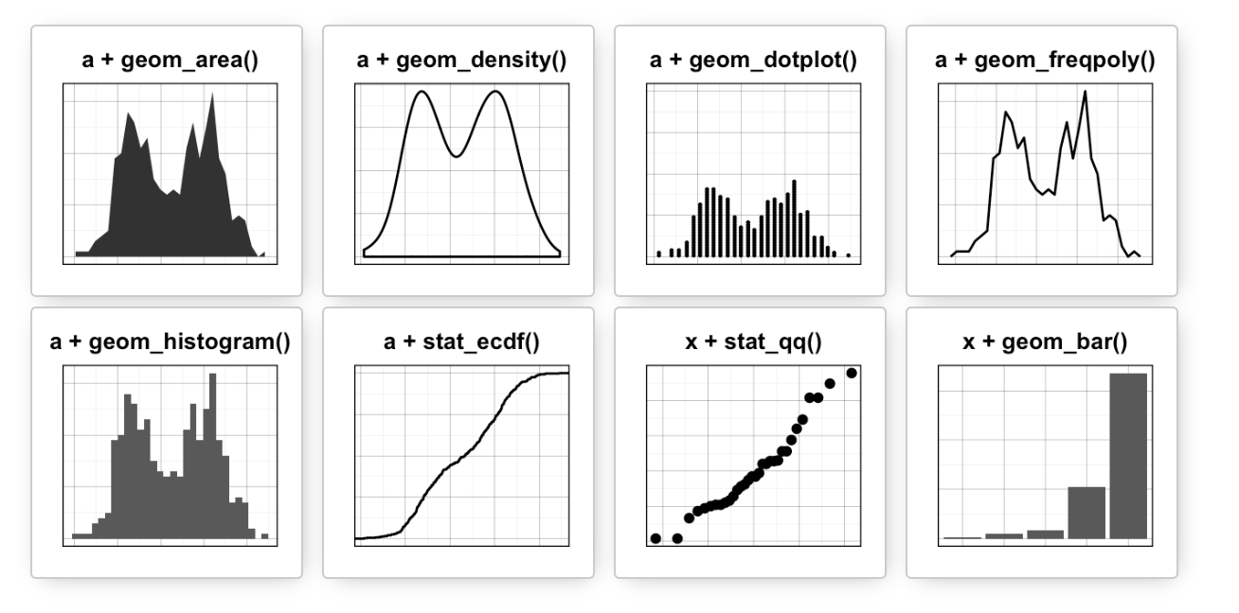
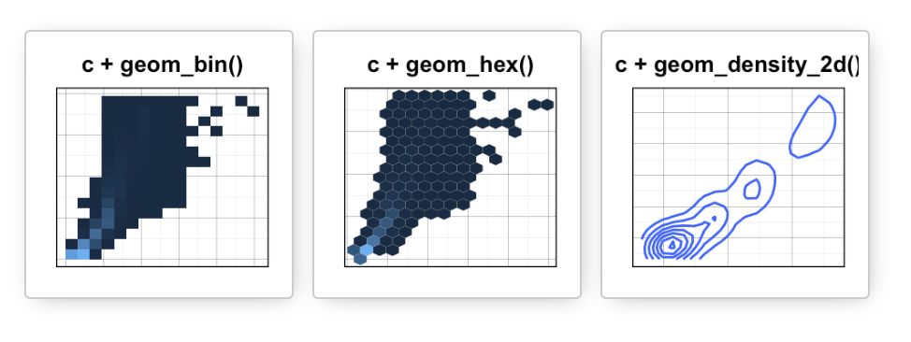
Data
Aesthetics
Geometries
Statistics
Scales
Themes
Exporting

Slide 26
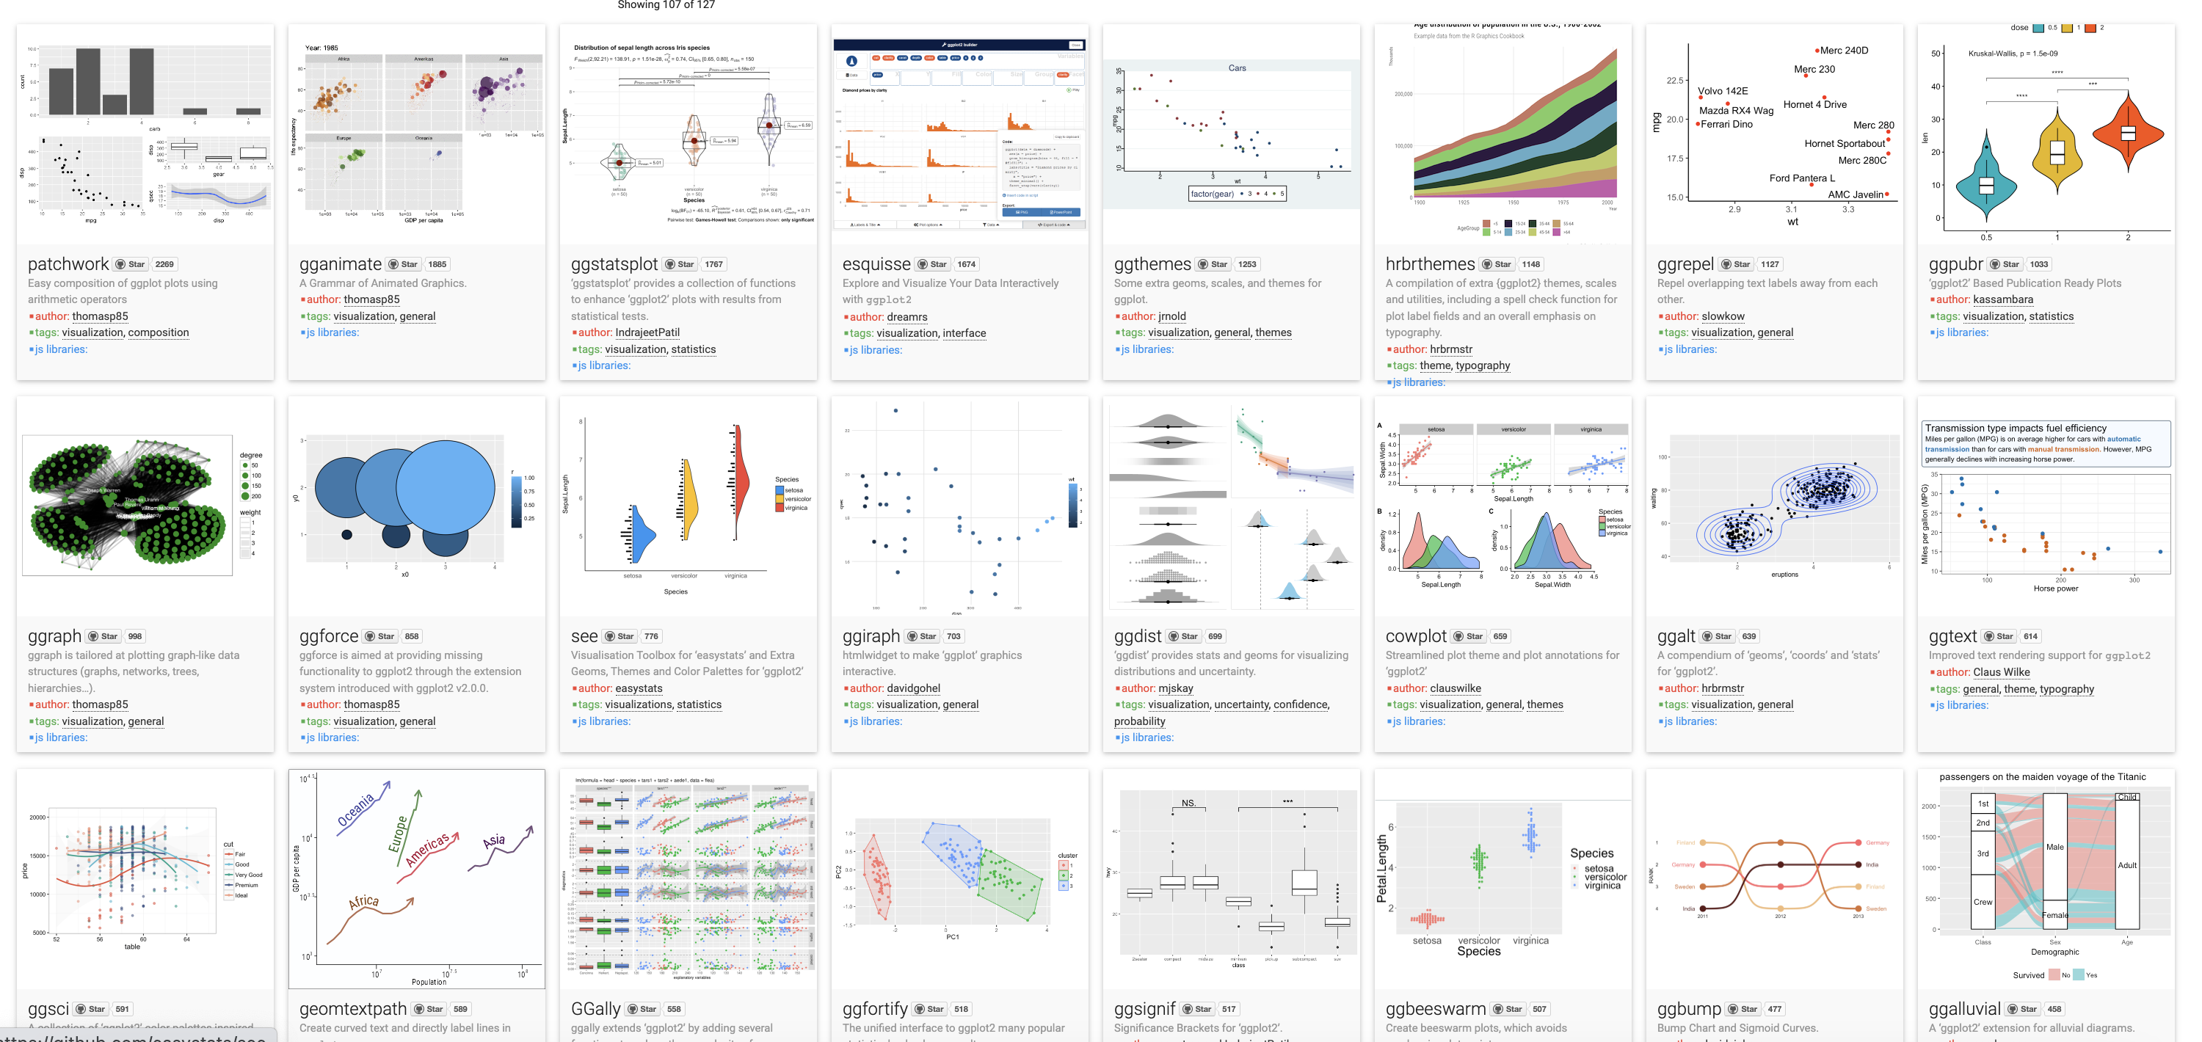
Over 120 ggplot2 extension libraries

Slide 27
Data
,
) +
ggplot(
data = yourdata
,
aes(x axis, y axis)
Aesthetics
geometry function
Geometries
ggplot(
data = happy
,
) +
aes(x=GDP, y=happiness)
geom_point()
Notes:
method chaining with a +

Slide 28
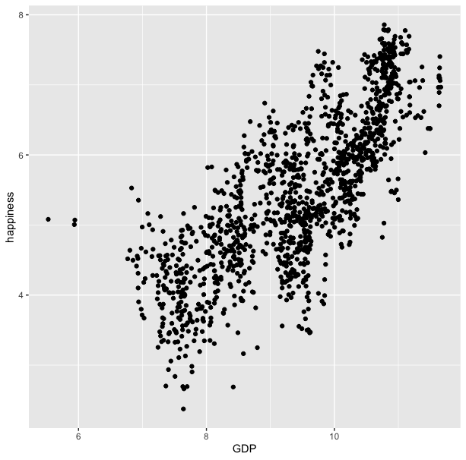
ggplot(
data = happy
,
) +
aes(x=GDP, y=happiness)
geom_point()

Slide 29
ggplot(
,
data = happy
aes(GDP, happiness)
) +
geom_point()
“and then…”
dplyr %>% or |>
ggplot +

Slide 30
ggplot(data = happy, aes(x=GDP, y=happiness))+
geom_point()

Slide 31
ggplot(
data = happy
,
) +
aes(x=GDP, y=happiness)
geom_point()

Slide 32
ggplot(
data = happy
,
aes(x=GDP, y=happiness)
) +
geom_point()
Notes:
ADD SLIDE BEF ORE WITHOUT Xs

Slide 33
ggplot(
data = happy
,
aes(x=GDP, y=happiness)
) +
geom_point()
ggplot(
happy
aes(GDP, happiness)
) +
,
geom_point()

Slide 34
ggplot(
data = happy
,
aes(x=GDP, y=happiness)
) +
geom_point()
ggplot(
happy
aes(GDP, happiness)
) +
,
geom_point()
ggplot(
) +
geom_point(
happy
aes(GDP, happiness)
,
)

Slide 35
ggplot(
data = happy
,
aes(x=GDP, y=happiness)
) +
geom_point()
ggplot(
happy
aes(GDP, happiness)
) +
,
geom_point()
ggplot(
) +
geom_point(
happy
aes(GDP, happiness)
,
)
,
happy
%>%
ggplot(
aes(GDP, happiness)
) +
geom_point()

Slide 36
ggplot(
data = happy
,
aes(x=GDP, y=happiness)
) +
geom_point()
ggplot(
happy
aes(GDP, happiness)
) +
,
geom_point()
ggplot(
) +
geom_point(
happy
aes(GDP, happiness)
,
)
,
happy
|>
ggplot(
aes(GDP, happiness)
) +
geom_point()
These all produce the same figure!

Slide 37
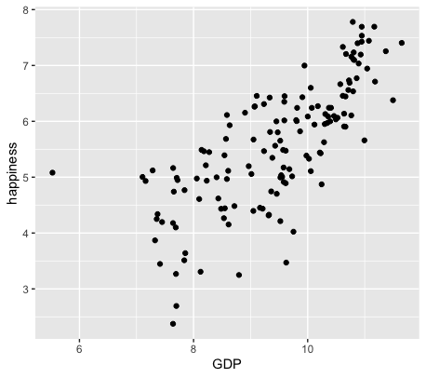
happy |>
filter(year == 2019) |>
ggplot(
aes(GDP, happiness)
) +
geom_point()

Slide 38
Aesthetics define any data that gets mapped to geometry
ggplot(data = yourData,
aes(x = xaxis,y = yaxis))+
geom_point()
Notes:
method chaining with a +

Slide 39
If it relates to a variable in your data, it goes inside the aesthetic function
ggplot(data = yourData,
aes(x = xaxis,y = yaxis))+
geom_point()
Notes:
method chaining with a +

Slide 40
If it relates to a variable in your data, it goes inside the aesthetic function
ggplot(data = happy,
aes(x = happiness,y = GDP,
shape= ,
size= ,
col= ))+
geom_point()
Notes:
method chaining with a +

Slide 41
ggplot(happy, aes(GDP, happiness)) +
geom_point()

Slide 42
ggplot(happy, aes(GDP, happiness)) +
geom_point(aes(col=continent))

Slide 43
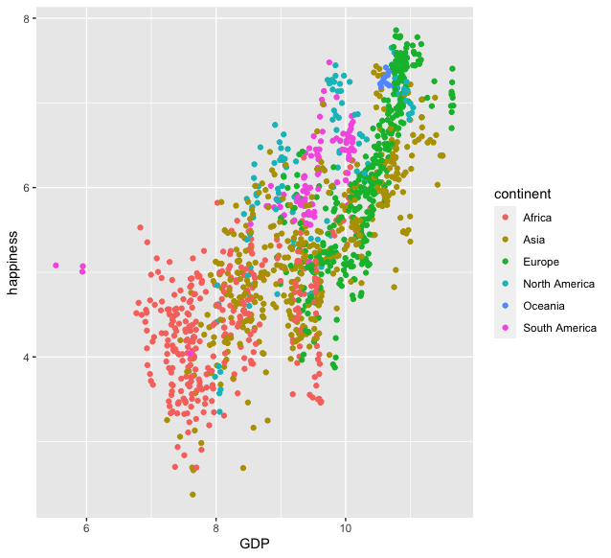
ggplot(happy, aes(GDP, happiness)) +
geom_point(aes(col=continent))

Slide 44
ggplot(happy, aes(GDP, happiness)) +
geom_point(aes(col=continent))
ggplot(happy, aes(GDP, happiness)) +
geom_point(col=‘blue’)

Slide 45
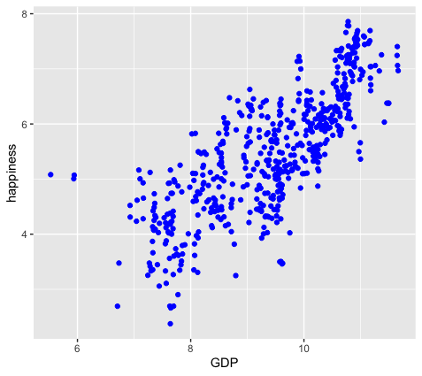
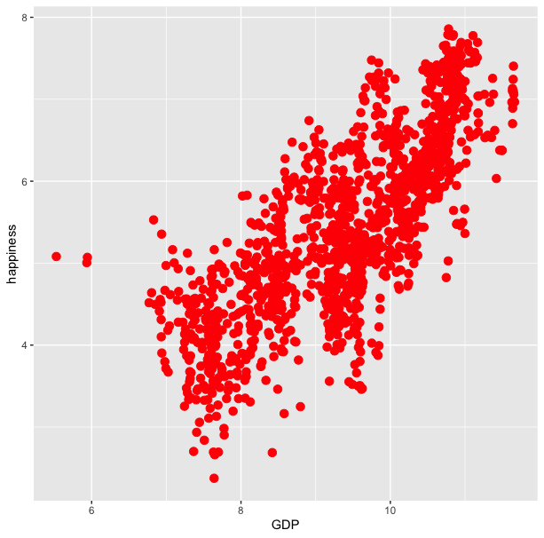
ggplot(happy, aes(GDP, happiness)) +
geom_point(aes(col=continent))
ggplot(happy, aes(GDP, happiness)) +
geom_point(col=‘blue’)

Slide 46
ggplot(happy, aes(GDP, happiness)) +
geom_point(aes(col=continent))
ggplot(happy, aes(GDP, happiness)) +
geom_point(col=‘blue’)
ggplot(happy, aes(GDP, happiness)) +
geom_point(aes(col=‘blue’))

Slide 47
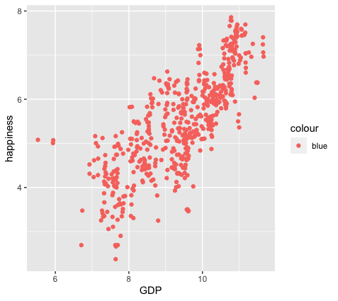
ggplot(happy, aes(GDP, happiness)) +
geom_point(aes(col=continent))
ggplot(happy, aes(GDP, happiness)) +
geom_point(col=‘blue’)
ggplot(happy, aes(GDP, happiness)) +
geom_point(aes(col=‘blue’))

Slide 48
colour
blue
blue
blue
blue
blue
blue
ggplot(happy, aes(GDP, happiness)) +
geom_point(aes(col=‘blue’))

Slide 49
ggplot(happy, aes(GDP, happiness)) +
geom_point()
We can also set conditional formatting.
e.g. Use different colors for points where happiness is > 5

Slide 50
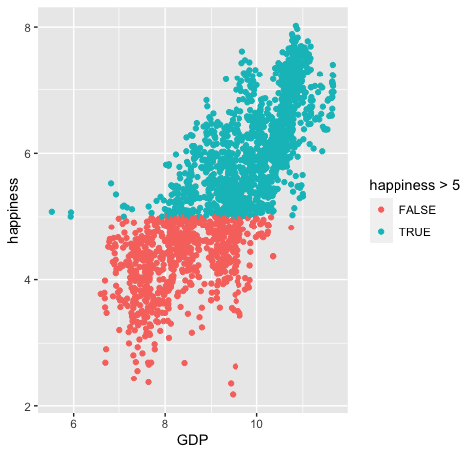
ggplot(happy, aes(GDP, happiness)) +
geom_point()
ggplot(happy, aes(GDP, happiness)) +
geom_point(aes(col=happiness > 5)

Slide 51
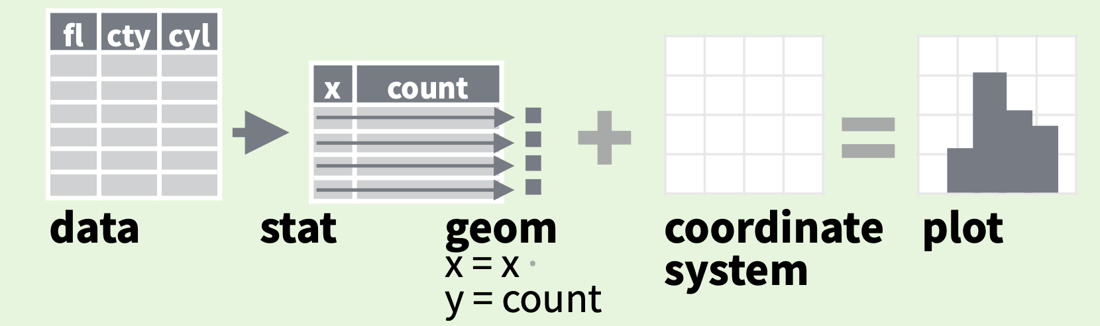
stats
Every geom function specifies a stat
Data
Aesthetics
Geometries
Statistics
Scales
Themes
Exporting

Slide 52
stats
Every geom function specifies a stat
Notes:
For example: If we wanted to make a bar plot that shows how frequently each of the continents is represented in our dataset.

Slide 53
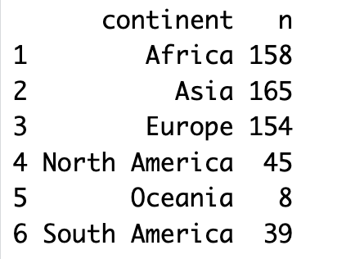
stats
If we wanted to count and plot the number of data points from each continent:
happy |>
count(continent)
Notes:
For example: If we wanted to make a bar plot that shows how frequently each of the continents is represented in our dataset.

Slide 54
stats
Every geom function specifies a stat
ggplot(happy, aes(continent)) +
geom_bar()
Notes:
ADD INFO ABOUT THE SILENT STAT=SUM

Slide 55
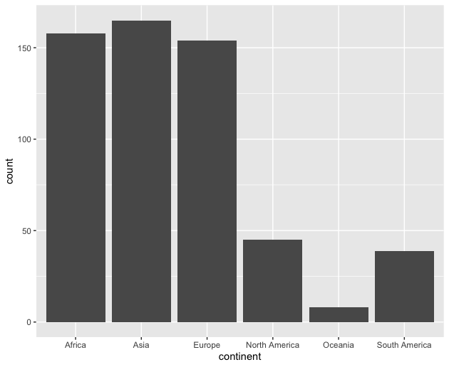
stats
geom_bar’s default statistic is count
ggplot(happy, aes(continent)) +
geom_bar()

Slide 56
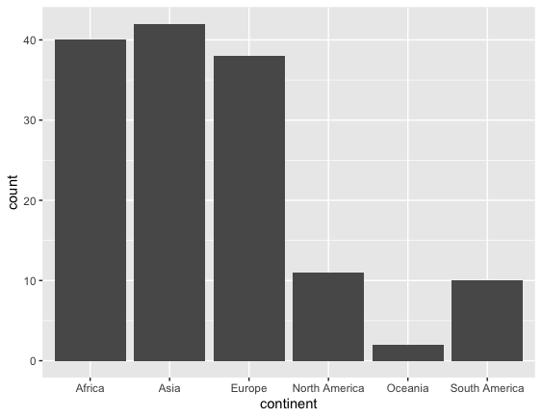
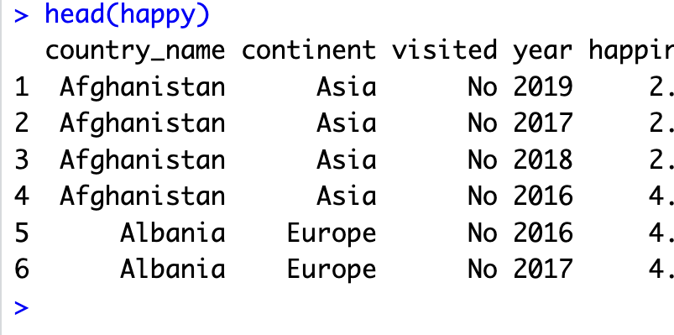
happy |>
filter(year=2019) |>
ggplot(aes(continent)) +
geom_bar()

Slide 57
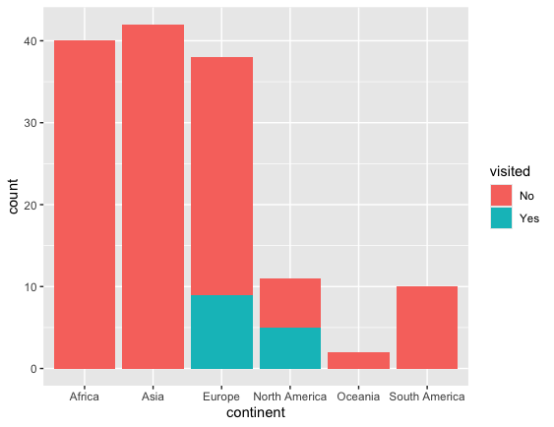
happy |>
filter(year=2019) |>
ggplot(aes(continent)) +
geom_bar(aes(fill=visited)

Slide 58
stat
Every geom function specifies a stat
Use a stat function (calls a default geom to make a layer)
Data
Aesthetics
Geometries
Statistics
Scales
Themes
Exporting

Slide 59
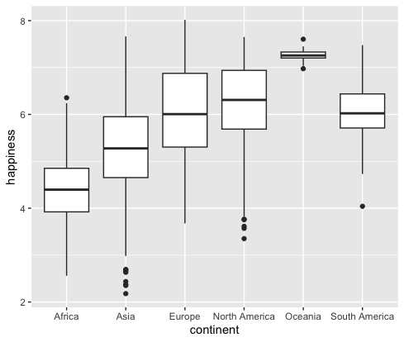
stat
Every geom function specifies a stat
Use a stat function (calls a default geom to make a layer)
ggplot(happy, aes(continent, happiness)) +
geom_boxplot()

Slide 60
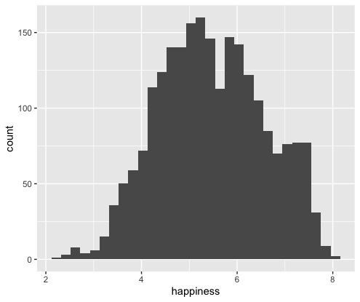
stat
Every geom function specifies a stat
Use a stat function (calls a default geom to make a layer)
ggplot(happy, aes(happiness)) +
geom_histogram()

Slide 61
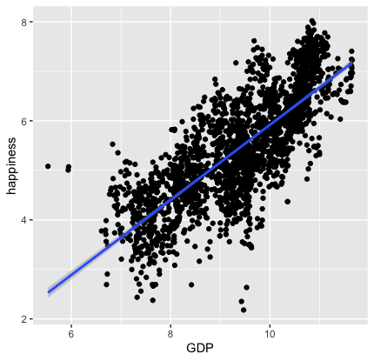
stat
Every geom function specifies a stat
Use a stat function (calls a default geom to make a layer)
ggplot(happy, aes(GDP, happiness)) +
geom_point()+
stat_smooth(method = "lm",
formula = y ~ x)

Slide 62
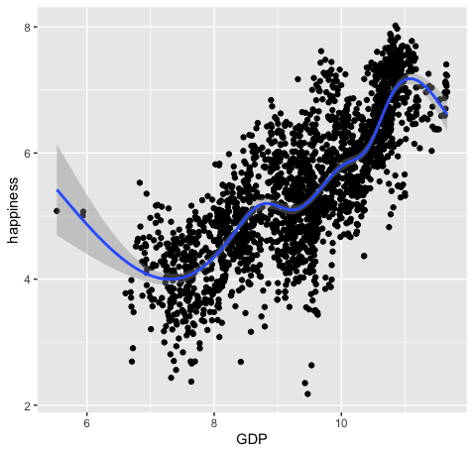
ggplot(happy, aes(GDP, happiness)) +
geom_point() +
geom_smooth()
ggplot(happy, aes(GDP, happiness)) +
geom_point() +
stat_smooth()

Slide 63
Scales
Data
Scales permeate all aspects of plotting in ggplot2
Most defaults will be enough
BUT learning how to manipulate them will give you much more control.
Aesthetics
Geometries
Statistics
Scales
Themes
Exporting

Slide 64
Scales
Data
Scales permeate all aspects of plotting in ggplot2
Most defaults will be enough
BUT learning how to manipulate them will give you much more control.
Aesthetics
Geometries
Statistics
Scales
Themes
Exporting

Slide 65
Scales
Data
Scales permeate all aspects of plotting in ggplot2
Most defaults will be enough
BUT learning how to manipulate them will give you much more control.
Aesthetics
Geometries
Statistics
Scales
Themes
Exporting

Slide 66
Three kinds of scales you are most likely to use:
Axes Limits
Bins
Colors

Slide 67
Three kinds of scales you are most likely to use:
Axes Limits
Bins
Colors
Ill cover these during the live demo portion

Slide 68
Three kinds of scales you are most likely to use:
Axes Limits
Bins
Colors
I want to spend some time talking about color scales

Slide 69
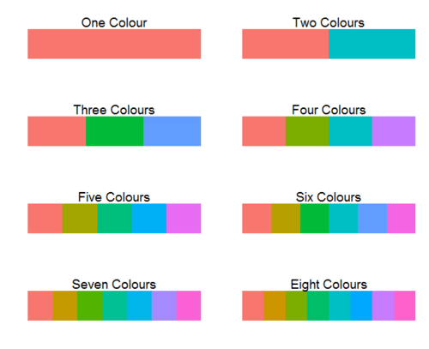
ggplot2 default colors for factors

Slide 70
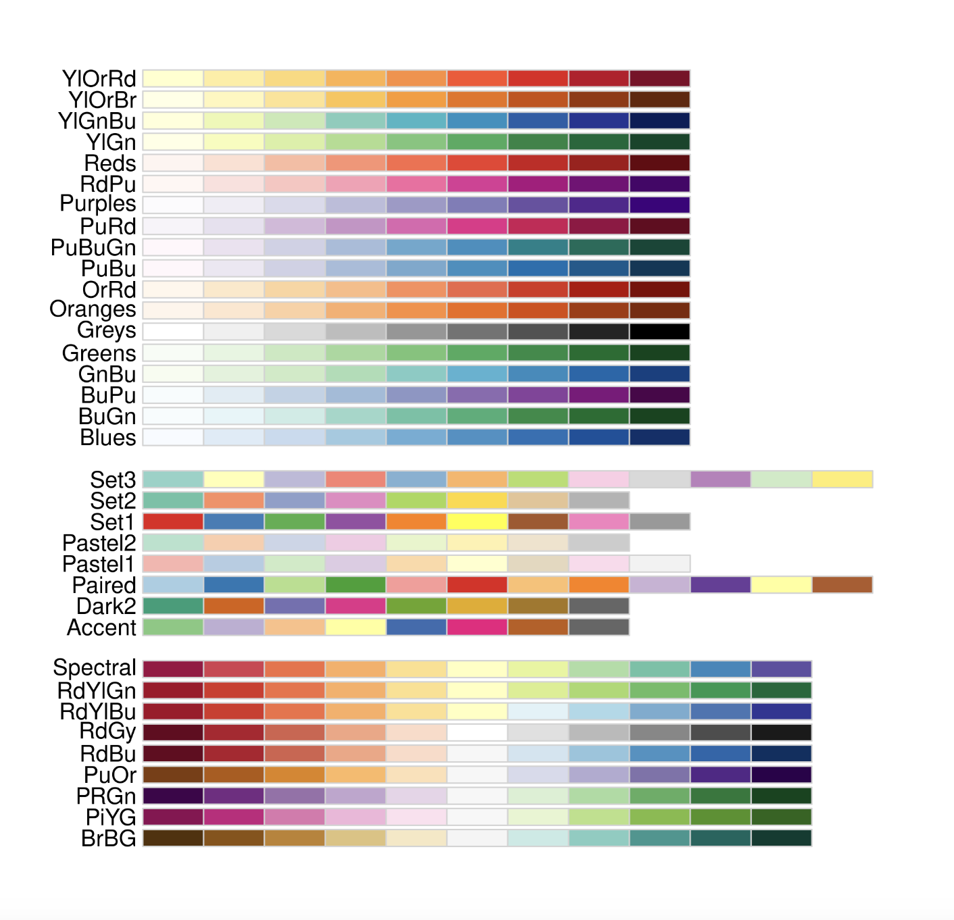
Brewer Scales
Monochrome scales
Qualitative scales
Divergent color scales
Notes:
Qualitative – nominal (no order)

Slide 71
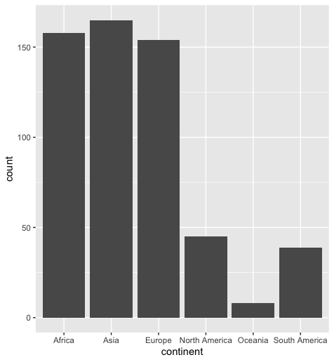
Brewer Scales
ggplot(happy, aes(continent))+
geom_bar()
Notes:
take out col=continent

Slide 72
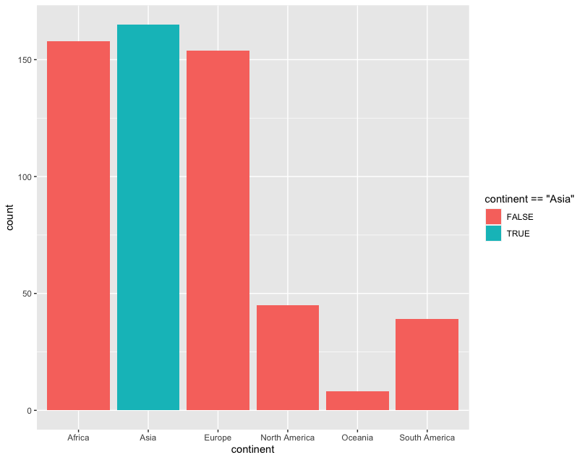
Brewer Scales
ggplot(happy, aes(continent))+
geom_bar(aes(fill=continent==‘Asia’))
Notes:
CORRECT CODE

Slide 73
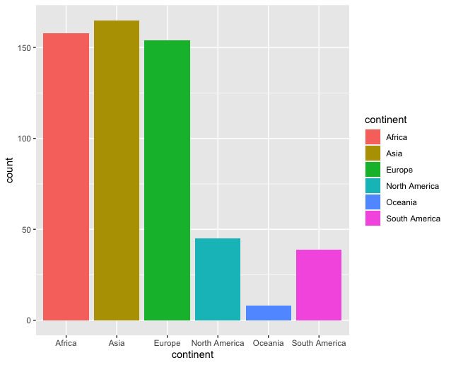
Brewer Scales
ggplot(happy, aes(continent))+
geom_bar(aes(fill=continent==‘Asia’))
Notes:
USE A DIFFERENT EXAMPLE USING A HIGHLIGHT COLOR

Slide 74
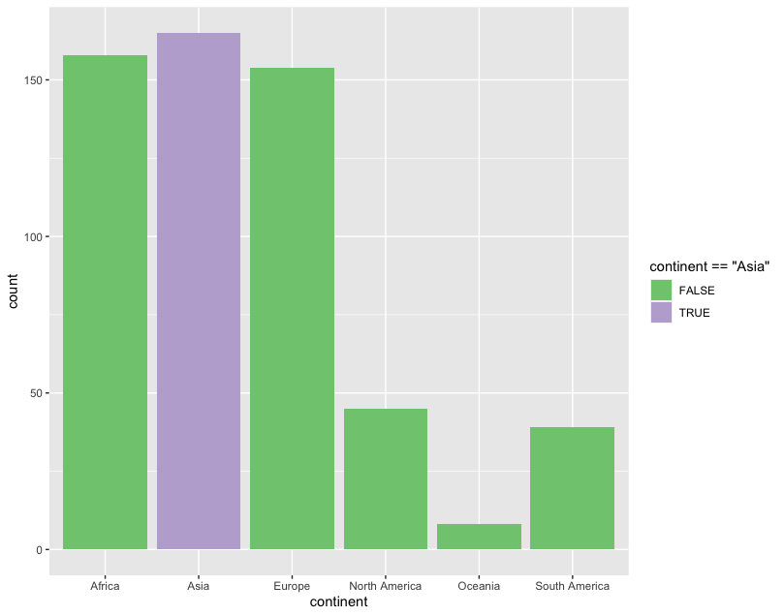
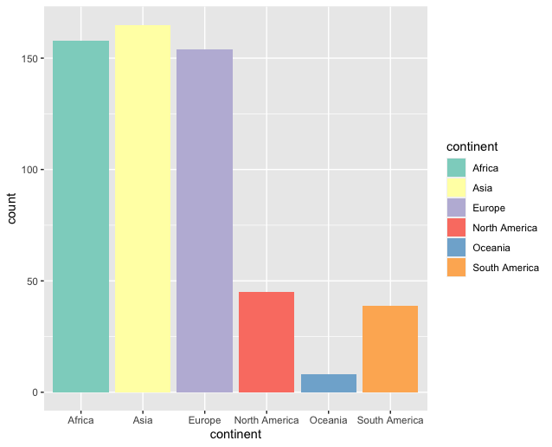
Brewer Scales
ggplot(happy, aes(continent))+
geom_bar(aes(col=continent==‘Asia’))+
scale_fill_brewer(palette = “Accent”)

Slide 75

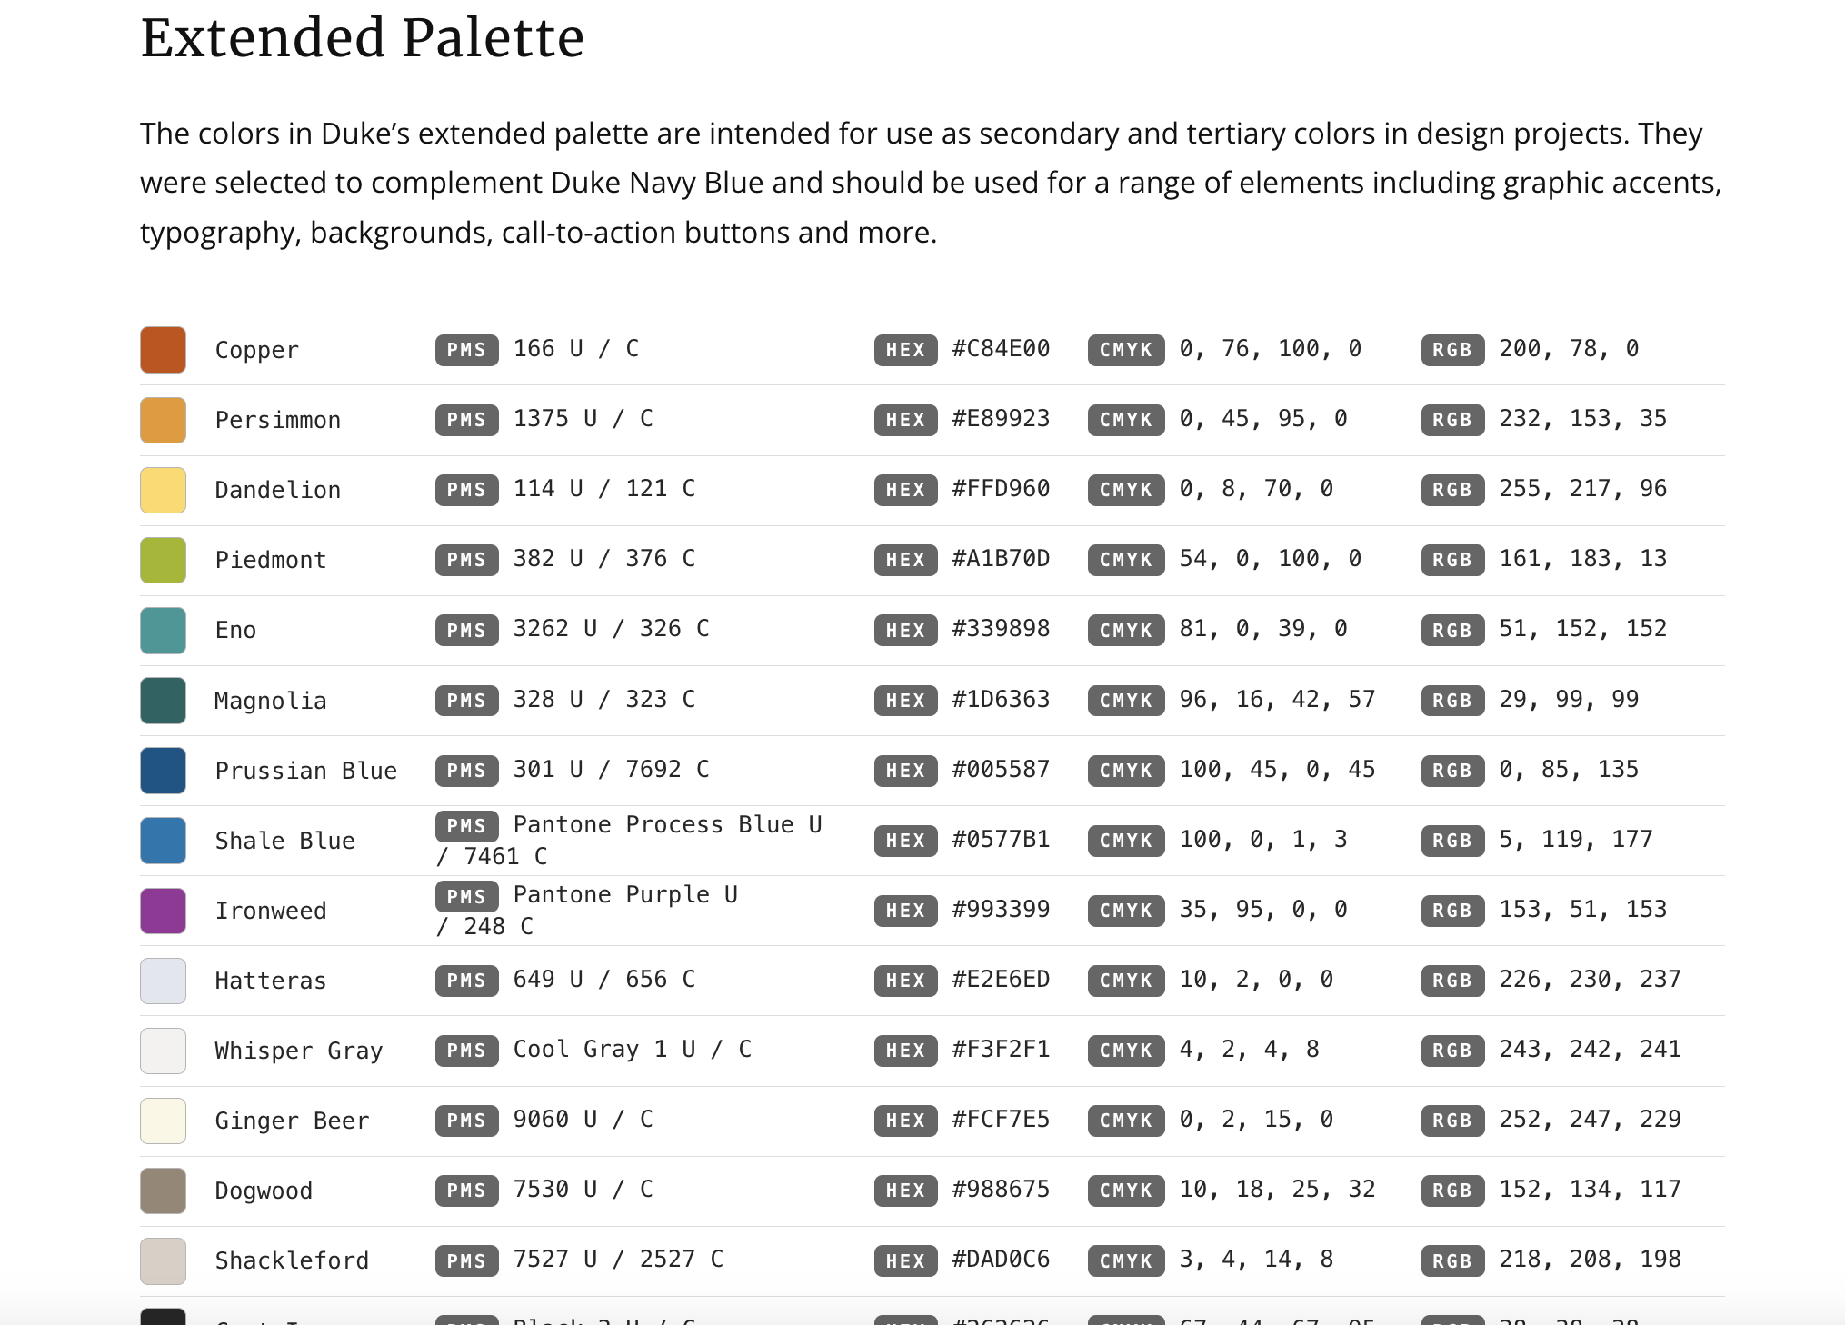
http://brand.duke.edu/colors

Slide 76

http://brand.duke.edu/colors

Slide 77
Custom Scales
Notes:
USE A DIFFERENT EXAMPLE. Add slides showing how you can use neutral and highlight colors

Slide 78
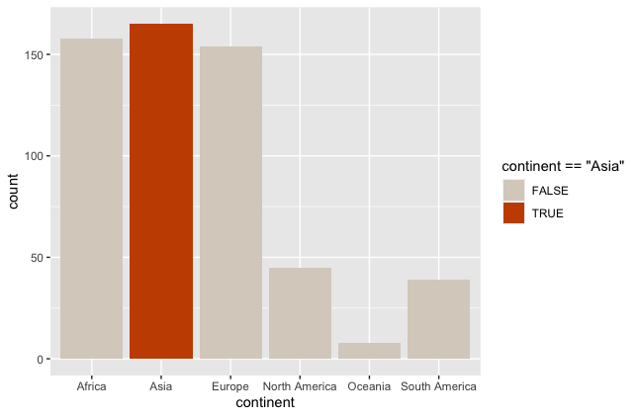
Custom Scales
ggplot(happy, aes(GDP, happiness))+
geom_bar(aes(col=continent==‘Asia’))+
scale_fill_manual(value = DukeColors)
Notes:
USE A DIFFERENT EXAMPLE. Add slides showing how you can use neutral and highlight colors

Slide 79
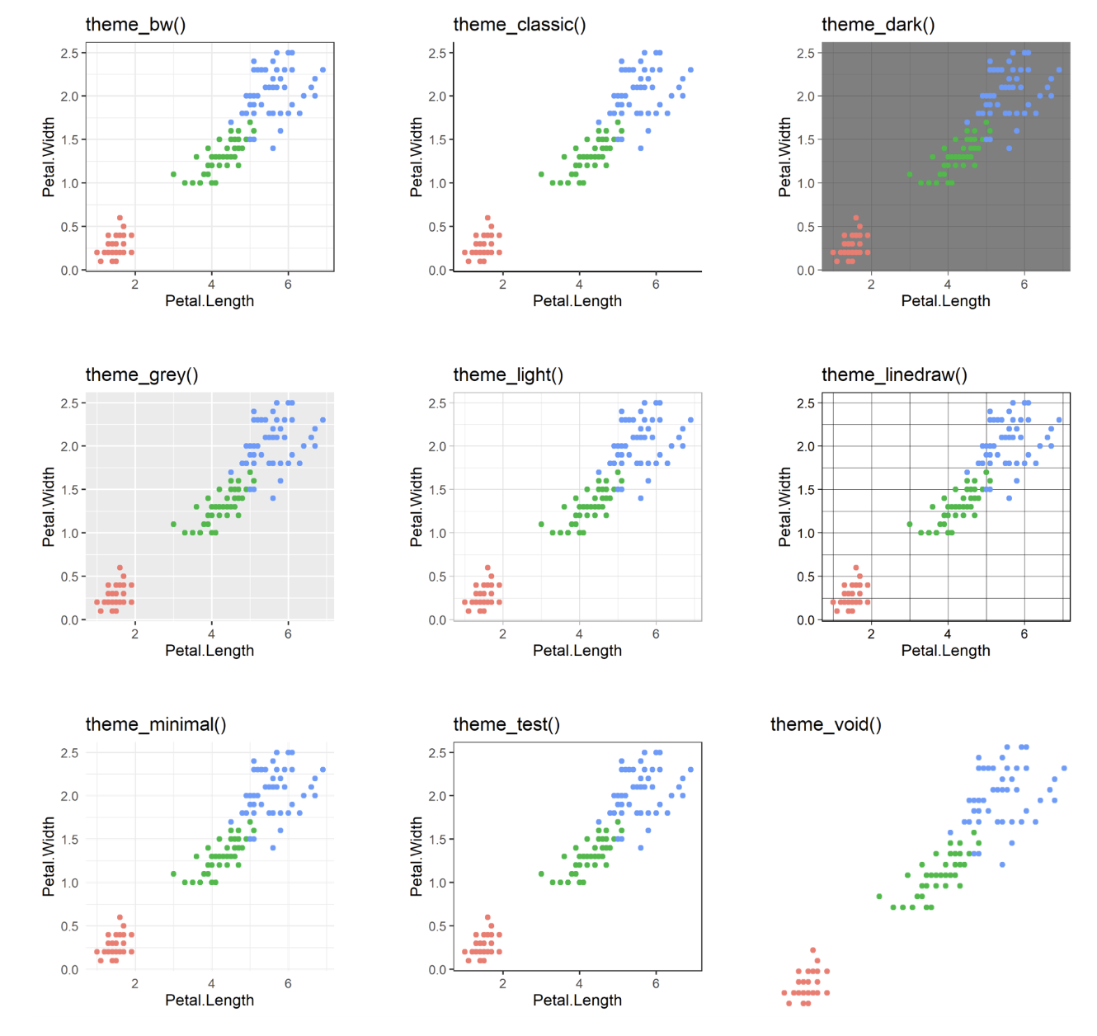
60 preexisting themes
easy to call
Data
Aesthetics
Geometries
Statistics
Scales
Themes
Exporting

Slide 80
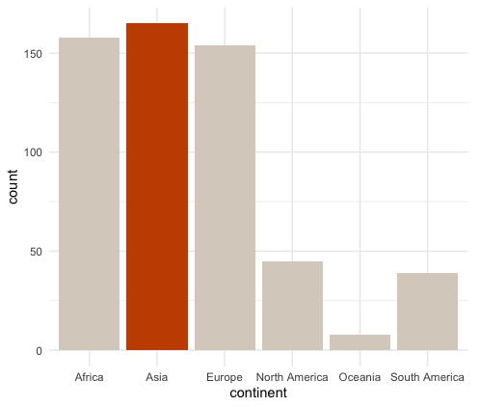
ggplot(happy, aes(GDP, happiness))+ geom_bar(aes(col=continent==‘Asia’))+
scale_fill_manual(value = DukeColors)
ggplot(happy, aes(GDP, happiness))+ geom_bar(aes(col=continent==‘Asia’))+
scale_fill_manual(value = DukeColors)+
theme_minimal()

Slide 81
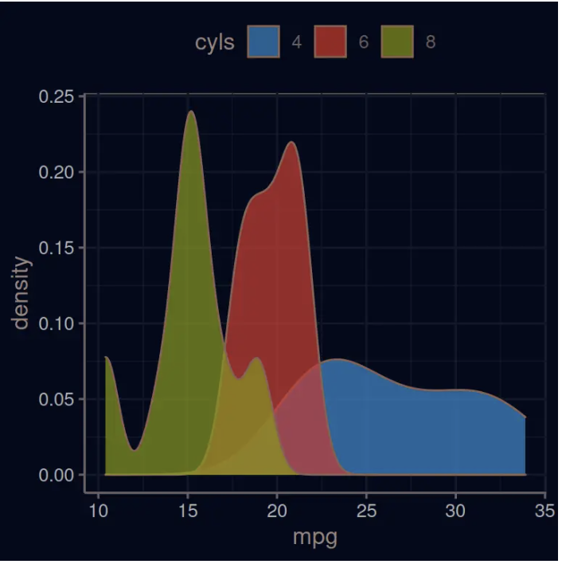
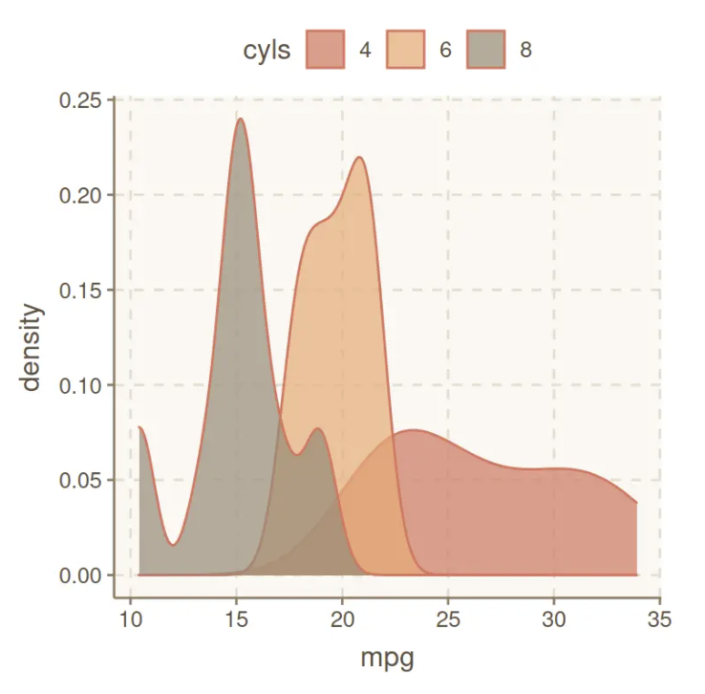
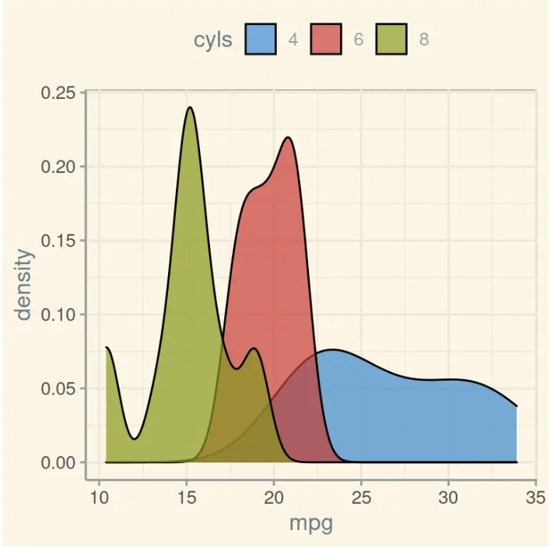
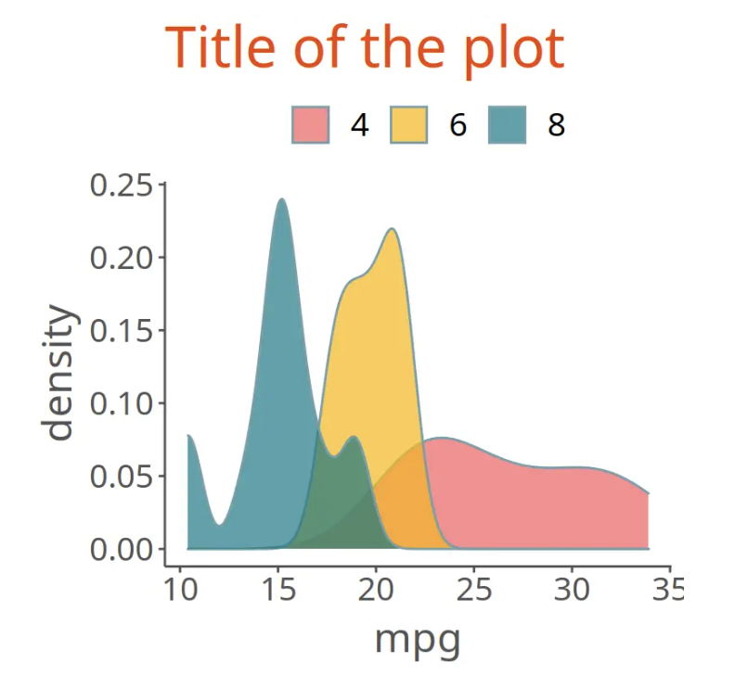
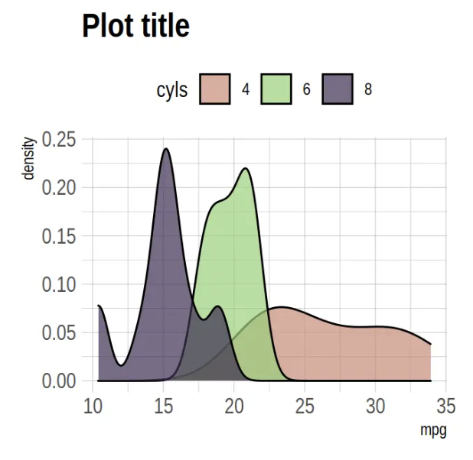
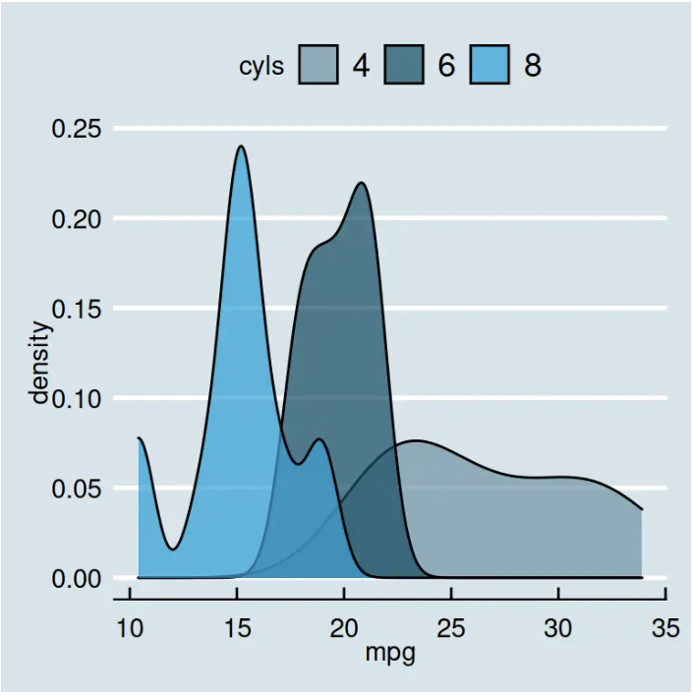
Over 60 pre-existing themes
Data
Aesthetics
Geometries
Statistics
Scales
Themes
Exporting
https://r-charts.com/ggplot2/themes/

Slide 82
60 preexisting themes
easy to call
Data
Aesthetics
Geometries
Statistics
Scales
Themes
Exporting

Slide 83




?theme()
…

Slide 84
ggplot(happy, aes(GDP, happiness))+ geom_bar(aes(col=continent==‘Asia’))+
scale_fill_manual(value = DukeColors)+
theme_minimal()

Slide 85

ggplot(happy, aes(GDP, happiness))+ geom_bar(aes(col=continent==‘Asia’))+
scale_fill_manual(value = DukeColors)+
theme_minimal()+
theme(axis.line.x.bottom=element_line(),
axis.line.y.left=element_line()

Slide 86

Data
Aesthetics
Geometries
Statistics
Scales
.pdf
Themes
Exporting

Slide 87


Slide 88
Lets give it a try
github.com/laurennichols/ggplot2_workshop

